Slide 1


Purchasing Training
WSU Student Engagement Services ASWSU | CCE | CFSL | CSOL | GPSA | SEB | Student Media
For Students & Staff
Notes:
Chloe Intro

Slide 2



Meet your Student Engagement Services Fiscal Team
Chloe Campbell
Finance/Budget Manager
Kandi Kambitsch
Fiscal Analyst
Denise Boyd
Fiscal Specialist
Notes:
Chloe

Slide 3
WSU
Approvals & Deadlines! - Please plan ahead!
Prior approval is required! To assure compliance with all regulations, all purchases must have the appropriate prior approval. Any person making an unauthorized purchase must assume full responsibility for that purchase. (BPPM 70.01-4.1)
Deadlines for form submissions:
Purchase Requests: at least 72 hours prior to the event/purchase - longer for online orders
Prize Purchase Requests: at least 7 business days prior to the event/purchase - longer for online orders
Contract, Performance or Speaker Requests: at least 4 weeks prior to event/purchase
NOTE: There is a separate training that covers anything travel-related, (travel requests/approval, registration fees, hotel/lodging requests, motor pool rentals, airline fees, travel expenses, etc.). Please be sure to attend!
Important Purchasing Information and Policies:
https://getinvolved.wsu.edu/media/dw3dz0s5/purchasing-information-2025-for-forms-site.pdf
WSU Business Policies & Procedures Manual (BPPM):
https://policies.wsu.edu/prf/index/manuals/bppm-table-contents/
Services & Activities (S&A) Fee Spending Guide:
https://budget.wsu.edu/documents/2019/06/sa-spending-guide.pdf/
Notes:
Chloe

Slide 4
WSU
Forms and Information
Forms Website:
https://getinvolved.wsu.edu/forms *** Please add a bookmark to this website! ***
Forms:
Purchase Request
Contract, Performance or Speaker Request
Sponsorship & Revenue Request
Non-Travel Reimbursement Request
List of Attendees
Prize Distribution Log
Ticket Sales Deposit & Ticket Sales Log
Plus, Various Travel Related Forms
Notes:
Chloe

Slide 5
WSU
Items REQUIRED on ALL forms:
Account Number - PG or GF #
(include split information if split between two accounts – 50%/50%, other % splits, specific amounts, etc.)
Requester’s Signature
Advisor’s Signature
Supplier/Vendor Name & Location
Event or purchase specifics
Estimated cost/amount
If a quote or confirmation is provided, please send it with the Purchase Request form.
All orders MUST be delivered to an on-campus location, not a personal address.
Incomplete forms will be returned with no action taken by the Fiscal Team.

Slide 6
WSU
Please complete ALL fields on the forms!
Prior approval is REQUIRED for ALL purchases & expenditures.
Completed request forms must include advisor approval.
Submit your completed forms to your advisor BEFORE the DEADLINE!
Your advisor will email the approved request forms to the SES Fiscal Team at getinvolved.finance@wsu.edu.
DO NOT initiate a purchase/expense with a supplier/vendor prior to receiving both advisor AND SES Fiscal Team approval.
PRIOR APPROVAL needs to be provided to ensure it is an allowable purchase, per WSU policy. If you complete a purchase yourself prior to receiving all approvals, you assume full liability for the expense, and we cannot guarantee that you will be reimbursed. “To assure compliance with all regulations, all purchases must have the appropriate prior approval. Any person making an unauthorized purchase must assume full responsibility for that purchase.” (BPPM 70.01-4.1)
Purchases should NOT be made/completed/ordered until the SES Fiscal Team has reviewed all required documents and provided approval, per WSU policy.
Additional Approvals
It is the responsibility of the group to obtain any additional approvals that may be required (Involve, WSU branding/logos, etc.).
Notes:
Denise no links needed

Slide 7
WSU
Purchase Request Form Options
There are several different ways that WSU can pay for goods and services. These are all options listed on our Purchase Request form – please be sure to select the appropriate request type.
Pcard (Procurement Card, Purchasing Card, Visa)
PO (Purchase Order)
IRI (WSU Interdepartmental Invoice & Requisition)
Supplier Invoice Request or WIV (Washington Invoice Voucher)
WSU CougarCard (departmental card)
Notes:
Chloe

Slide 8
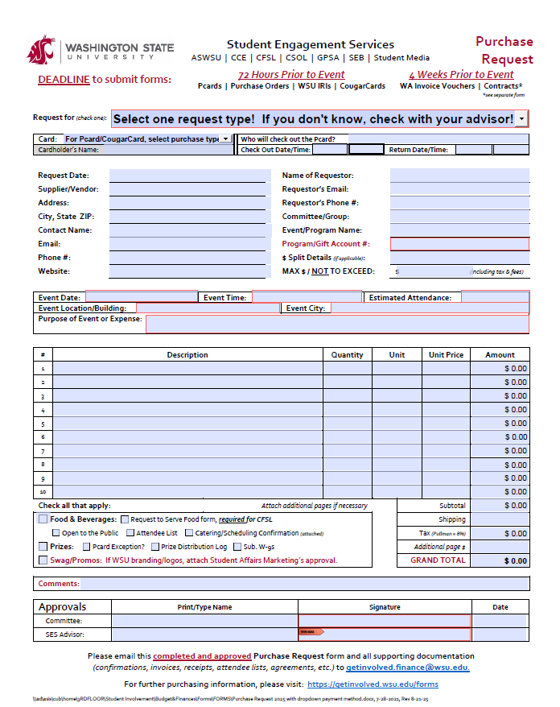
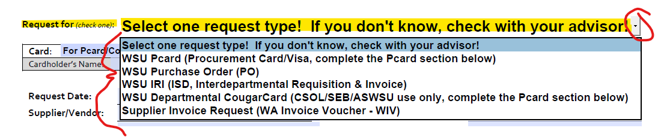
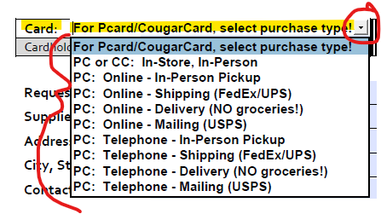
WSU
Form Link:
https://getinvolved.wsu.edu/forms
New dropdown options!
Notes:
Denise -

Slide 9
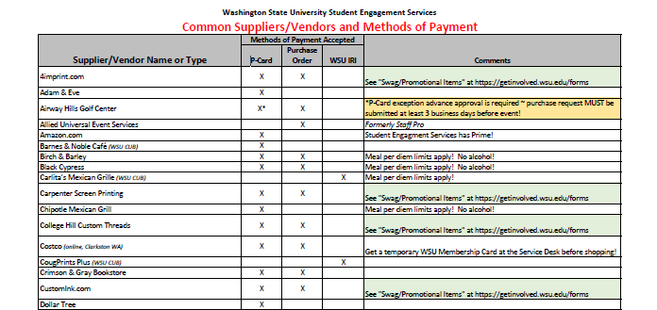
WSU
Not sure where to start?
Check in with your advisor FIRST, or any of the SES/CSOL advisors or staff!
We have a list of some of our common suppliers/vendors and methods of payments accepted at https://getinvolved.wsu.edu/forms. Visit this website for a longer list of suppliers/vendors; however, if your supplier/vendor is not listed be sure to check with them directly on payment options.
Form Link:
https://getinvolved.wsu.edu/forms
Notes:
Denise - Link to Purchasing information

Slide 10
WSU
Pcard Requests
Procurement cards (Pcards) are available for online and in-person purchases.
On the Purchase Request form, include the name of individual checking out a Pcard along with checkout and return dates & times.
Pcard checkout and return times are Monday through Friday, 8:00 a.m. to 3:30 p.m.; advisors can approve overnight/weekend requests. Please stick to the agreed-upon time for Pcard checkout and return to ensure they are available for the next person checking out the Pcard.
Only WSU Student Engagement Services approved employees (permanent staff, student employees, stipend recipients) may check out a Pcard. A Pcard Delegation form is required to be approved and on file with the Fiscal Team before use.
Submit your completed Purchase Request forms along with any other supporting documentation to your advisor at least 72 hours prior to your event or purchase date (allow more time for online orders)!
Your advisor will email the approved request forms and any supporting documentation to the SES Fiscal Team at getinvolved.finance@wsu.edu.
When ordering online, ensure that the Pcard number IS NOT SAVED in a personal account; our SES Fiscal Team assists with online orders using (or setting up) business accounts. Keep the Pcard secure until you return it to the SES Fiscal Team (or advisors). Report lost or stolen cards IMMEDIATELY to the Cardholder.
Scan and email any receipts, invoices, attendee lists, etc. to getinvolved.finance@wsu.edu immediately after the event.
Notes:
Denise

Slide 11
WSU
Pcard Requests (cont’d)
Pcard Restricted Purchases
Pcards CANNOT be used at the following merchants:
Carlita’s (CUB)
Freshens (CUB or Chinook)
Little Caesars (CUB)
Starbucks (Spark)
WinCo
WSU Athletics
WSU CougPrints Plus
WSU Creamery/Ferdinand’s
WSU (Any Other) Departments
WSU Transportation Services
You are not allowed to purchase WSU products (excluding items with WSU logo) from any outside vendors (for example, Cougar Gold Cheese should be purchased directly from WSU Ferdinand’s, not Rosauers).
Some purchases are restricted/prohibited for Pcard transactions, and a restricted purchase exception request is needed prior to the purchase. Please allow additional time for the SES Fiscal Team to request approval. The primary restricted Pcard purchases include (but are not limited to) alcohol, entertainment, equipment/furnishings, fuel, internal WSU department purchases, personal purchases, speaker fees, travel, and weapons.
Notes:
Denise

Slide 12
WSU
PO Requests
Purchase Orders (POs) are used for transactions with suppliers/vendors outside of WSU (i.e., Rosauers, Safeway). The supplier/vendor will submit an invoice to WSU (usually) after the purchase is made or service is provided.
Submit your completed Purchase Request forms along with any other supporting documentation to your advisor at least 72 hours prior to your event or purchase date!
Your advisor will email the approved request forms and any supporting documentation to the SES Fiscal Team at getinvolved.finance@wsu.edu.
Once the SES Fiscal Team sends the official PO to you, please provide it to the supplier/vendor.
Scan and email any receipts, invoices, attendee lists, etc. to getinvolved.finance@wsu.edu immediately after the event.
Notes:
Chloe

Slide 13
WSU
IRI Requests
WSU Interdepartmental Requisition & Invoices (IRIs) are used for internal WSU department transactions (i.e., Beasley, Ferdinand’s, University Catering).
Submit your completed Purchase Request forms along with any other supporting documentation to your advisor at least 72 hours prior to your event or purchase date!
Your advisor will email the approved request forms and any other supporting documentation to the SES Fiscal Team at getinvolved.finance@wsu.edu.
Some departments require IRIs IN ADVANCE of the purchase/expense (Carlitas, Ferdinand’s, Little Caesars, etc.) and some don’t require it until AFTER the event and they provide the final invoice (WSU Catering, Beasley, Scheduling, etc.). Once the SES Fiscal Team sends the official IRI to you, please provide it to the supplier/vendor.
Scan and email any receipts, invoices, attendee lists, revised IRIs, etc. to getinvolved.finance@wsu.edu immediately after the event.
Notes:
Chloe

Slide 14
WSU
Supplier Invoice Requests (and Washington Invoice Vouchers)
The Supplier Invoice Request form is used to make payments to an outside supplier/vendor, contractors, speaker fees, etc. when an invoice is provided by a supplier/vendor. The State of Washington Invoice Voucher (WIV) is used when a supplier/vendor is unable to provide an invoice to WSU.
Submit your completed Purchase Request forms along with any other supporting documentation to your advisor at least 72 hours prior to your event or purchase date! Additional processing time may be needed if the supplier/vendor is not already set up in Workday.
Your advisor will email the approved request forms and any supporting documentation to the SES Fiscal Team at getinvolved.finance@wsu.edu.
The SES Fiscal Team will send the official WIV form to the appropriate person/supplier/vendor.
Scan and email any receipts, invoices, attendee lists, revised IRIs, etc. to getinvolved.finance@wsu.edu immediately after the event.
Notes:
Chloe

Slide 15
WSU
WSU CougarCard Requests
The Student Engagement Services Office has departmental CougarCards for use for quick, low-cost purchases for CUB food & beverage retailers. These are available for use by ASWSU, CSOL, SEB & SES only.
On the Purchase Request form, include the name of individual checking out a CougarCard along with checkout and return dates & times. CougarCard checkout and return times are Monday through Friday, 8:00 a.m. to 3:30 p.m.; advisors can approve overnight/weekend requests. Please stick to the agreed-upon time for CougarCard checkout and return to ensure they are available for the next person checking out the CougarCard.
Only WSU Student Engagement Services approved employees (permanent staff, student employees, stipend recipients) may check out a departmental CougarCard!
Submit your completed Purchase Request forms along with any other supporting documentation to your advisor at least 72 hours prior to your event or purchase date!
Your advisor will email the approved request forms and any supporting documentation to the SES Fiscal Team at getinvolved.finance@wsu.edu.
Keep the CougarCard secure until you return it to the SES Fiscal Team (or advisors). Report lost or stolen cards IMMEDIATELY to the Fiscal Team.
Scan and email any receipts, invoices, attendee lists, etc. to getinvolved.finance@wsu.edu immediately after the event. The SES Fiscal Team will submit an IRI to the CougarCard Center after the event to replenish the funds used on the CougarCard.
Notes:
Chloe

Slide 16
WSU
Contract, Performance or Speaker Requests
The Contract, Performance or Speaker Request form is used whenever a contract or agreement is needed.
Submit your completed Contract, Performance or Speaker Request forms along with any other supporting documentation to your advisor at least 4 weeks prior to your event date!
*** During the Strategic Pause, please keep in mind contracts for $10,000+ require advance written approval by the Student Affairs Vice Provost, so please allow for additional processing time.***
Your advisor will email the approved request form and any other supporting documentation to the SES Fiscal Team at getinvolved.finance@wsu.edu.
Additional items needed for Contract, Performance or Speaker Requests
Contract/agreement form from the supplier/vendor/person
DO NOT SIGN ANY contracts/agreements on behalf of WSU!
Contracts/Agreements with WSU Departments: WSU SES Advisors can sign (but not SES GA’s).
Contracts/Agreements with NON-WSU Suppliers/Vendors: Only Brian Shuffield can sign for SES groups.
IRS W-9 tax form for the supplier/vendor/person is required if not already set-up in Workday.
Invoice, if available. If the supplier/vendor does not provide an invoice, a Washington Invoice Voucher can be used. Submit your completed Purchase Request form to your advisor at least 72 hours prior to your event date. Your advisor will submit the request form to the SES Fiscal Team at getinvolved.finance@wsu.edu. The SES Fiscal Team will send the official WIV form to the appropriate person/supplier/vendor.
NOTE: The address on W-9 and Invoice must match!!!
Notes:
Chloe

Slide 17
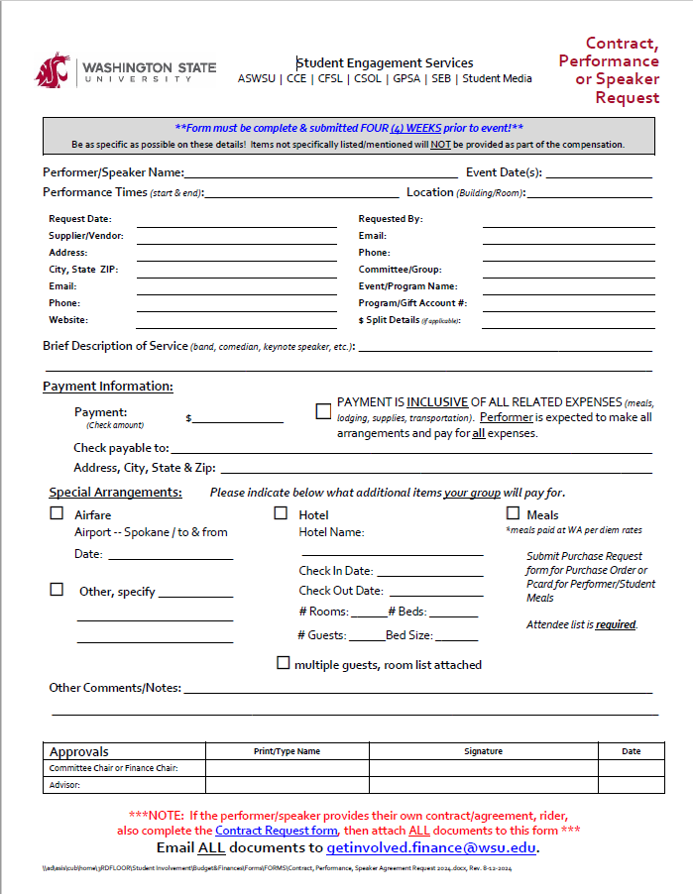
WSU
Form Link:
https://getinvolved.wsu.edu/forms
Notes:
Chloe

Slide 18
WSU
Sponsorships & Revenue
Many of our WSU SES committees/groups either give OR receive sponsorships to/from other groups/suppliers.
Submit your completed Sponsorships & Revenue Request forms along with any other supporting documentation to your advisor when:
A supplier/vendor is giving money/funds to a WSU department/group that is under the SES umbrella
A SES group is giving/receiving money/funds to/from another WSU department/group (including RSOs)
Accounting Journal/Adjustments will be submitted by the SES Fiscal Team for:
Prior purchases made by a WSU department/group.
To transfer the approved sponsorship funds between two WSU departments/groups (including RSOs)
*** Some fund type restrictions may apply.
Your advisor will email the approved request forms and any supporting documentation to the SES Fiscal Team at getinvolved.finance@wsu.edu.
The SES Fiscal Team will work with the sponsors/donors to determine the best way to
More information about payment options (checks, e-checks, ACH/EFT) can be found on the Sponsorships & Revenue request form.
NOTE: WSU is not allowed to donate funds to charities or groups (but “goods” can be purchased and donated).
Notes:
Chloe

Slide 19
WSU
Sponsorships & Revenue (cont’d)
Sponsorship Direct Purchase Option
If our office will facilitate a direct purchase of items/services for the sponsorship to a group/organization/RSO, please submit a completed Purchase Request form along with any supporting documentation to your advisor at least 72 hours prior to the event or purchase date!
Your advisor will email the approved request forms and any supporting documentation to the SES Fiscal Team at getinvolved.finance@wsu.edu.
NOTE: WSU is not allowed to donate funds to charities or groups (but “goods” can be purchased and donated).
Notes:
Chloe

Slide 20
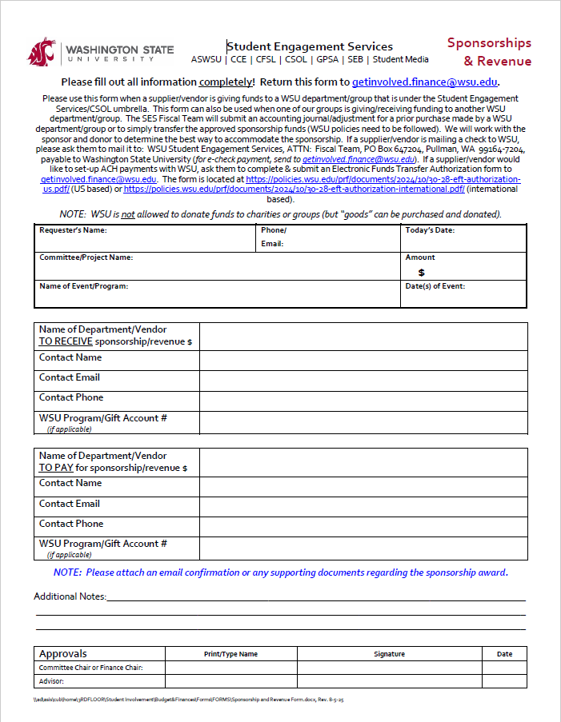
Form Link:
https://getinvolved.wsu.edu/forms
WSU
Form Instructions:
Please use this form when a supplier/vendor is giving funds to a WSU department/group that is under the Student Engagement Services/CSOL umbrella. This form can also be used when one of our groups is giving/receiving funding to another WSU department/group. The SES Fiscal Team will submit an accounting journal/adjustment for a prior purchase made by a WSU department/group or to simply transfer the approved sponsorship funds (WSU policies need to be followed). We will work with the sponsor and donor to determine the best way to accommodate the sponsorship. If a supplier/vendor is mailing a check to WSU, please ask them to mail it to: WSU Student Engagement Services, ATTN: Fiscal Team, PO Box 647204, Pullman, WA 99164-7204, payable to Washington State University (for e-check payment, send to getinvolved.finance@wsu.edu). If a supplier/vendor would like to set-up ACH payments with WSU, ask them to complete & submit an Electronic Funds Transfer Authorization form to getinvolved.finance@wsu.edu. The form is located at https://policies.wsu.edu/prf/documents/2024/10/30-28-eft-authorization-us.pdf/ (US based) or https://policies.wsu.edu/prf/documents/2024/10/30-28-eft-authorization-international.pdf/ (international based). Please allow at least 3 weeks for processing time. RSOs, please contact cougarcard@wsu.edu for your account status.
Notes:
Chloe

Slide 21
WSU
Food & Beverages: Per Diems & Attendees
Cost Limits
The cost per meal served may not exceed the applicable meal limits for the location (these rates include tax and gratuity/tip and any other food/beverage-related fees).
Pullman/Moscow meal per diem rates are currently:
Breakfast - $17.00
Lunch - $20.00
Dinner - $31.00
Other locations have different rates; consult your SES Fiscal Team or Advisor. Rates change annually on October 1st.
Attendees
Please indicate on the Purchase Request form if the event is “Open to Public” (when the number of participants is large or when the names of participants are unknown) or if you will provide an “Attendees List” (a list of participants, indicating each participant’s relationship to the University, e.g., employee, official, guest). Be sure to make this indication on the form!
Please use the List of Attendees located at getinvolved.wsu.edu/forms and include the event name and date and the guest’s relationship to WSU. If you use a format other than the List of Attendees form, please be sure to include event name and date, along with each guest's relationship to WSU. The List of Attendees should be submitted to the SES Fiscal Team at getinvolved.finance@wsu.edu immediately (no more than two business days) after the event.
Notes:
Denise

Slide 22
WSU
Food & Beverages: Per Diems & Attendees
Funding
If the account used is NOT a S&A fund, a request to serve food form is required (required for all CFSL accounts).
Receipts/Invoice
When purchasing food/beverages at a restaurant or similar supplier/vendor, we need the itemized receipt or invoice with the added gratuity/tip amount (printed/written & initialed on either the original itemized receipt or if a Pcard payment, then we need the original itemized receipt PLUS the credit card receipt that shows the total amount charged). Email all receipts/invoices to getinvolved.finance@wsu immediately (no more than two business days) after the event.
CUB Events
If your event will be held in a reserved space within the Compton Union Building (CUB), please view the food policy at https://cub.wsu.edu/about-the-cub/facility-policies/.
Beverages
For ON-CAMPUS EVENTS, ONLY Coca-Cola branded beverages may be purchased for or served/given away (exceptions may be allowed when it is included as part of a contract for a performer, etc.). For the Coca-Cola brand list, go to https://www.coca-colacompany.com/brands. The only allowable energy drink brands are: Full Throttle, Monster, NOS, Reign, and Bang. NOTE: This policy does not apply to beverages purchased for or served/given away at off-campus events. Alcohol is prohibited.
Notes:
Denise

Slide 23
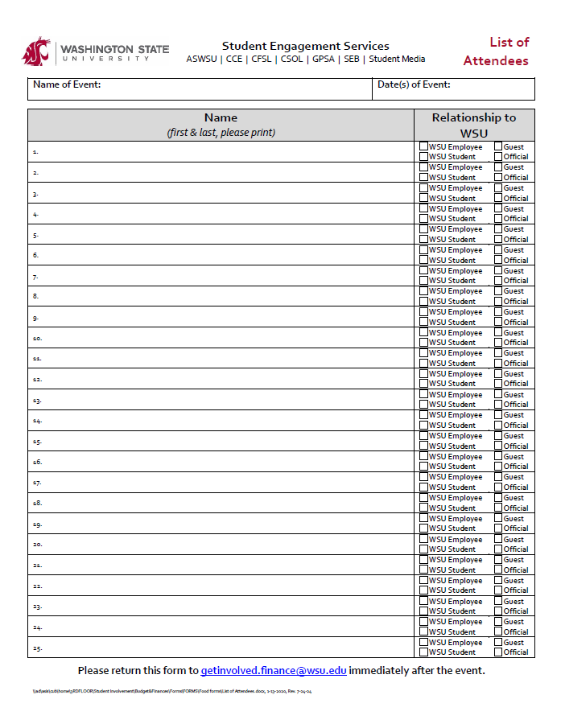
WSU
Form Link:
https://getinvolved.wsu.edu/forms
Notes:
Denise

Slide 24
WSU
Confirmations
If you receive any type of confirmation for orders, catering, etc., send it/them immediately to getinvolved.finance@wsu.edu. Students are not allowed to sign any agreements or contracts.
Order Arrival: Packing Slips/Lists
Notification of Order Arrival
If your order was delivered to WSU, the SES Fiscal Team will notify you when it arrives and where you can pick up your order.
We will attach a packing slip/list to your order (or a copy of the order).
Please sign and date the packing slip/list. Add notes if something is missing or damaged.
Give the signed and dated packing slip/list it to the SES Fiscal Team member, as this confirms you received everything ordered or send it to getinvolved.finance@wsu.edu.
Notes:
Denise

Slide 25
WSU
Receipts, Invoices & Gratuity
Itemized receipts or invoices (showing clearly/exactly what was purchased) are needed for ALL purchases/expenses.
Invoices need to include “WSU” or “Washington State University” and include a remit to address that matches their IRS W-9 form on file.
When purchasing food/beverages at a restaurant or similar supplier/vendor, we need the itemized receipt or invoice with the added gratuity/tip amount.
The gratuity/tip amount can be printed/written & initialed on the original itemized receipt.
If a Pcard payment, we need the original itemized receipt PLUS the credit card receipt that shows the total amount charged with your signature).
Email all receipts and invoices to getinvolved.finance@wsu.edu immediately (no more than two business days) after the event.
Notes:
Chloe

Slide 26
WSU
Prizes
Limits & Documentation
Please check with your advisor as prize limits apply!
$250 maximum amount per prize, $500 maximum amount per event, maximum number of prizes is 5 per event. Exceptions may be requested and must have written approval from Brian Shuffield or Matt Shaw.
Winner documentation is required!
Gift Cards are no longer an option for purchase.
See the table on the next page to determine what documentation is needed.
Submit your completed Purchase Request forms along with any other supporting documents to your advisor at least 72 hours prior to the event or purchase date (allow more time for online orders)!
Your advisor will email the approved request forms and any supporting documentation to the SES Fiscal Team at getinvolved.finance@wsu.edu.
Scan and email all required documents (Prize Distribution Log, Substitute W-9s) to getinvolved.finance@wsu.edu immediately after the event.
Notes:
Chloe

Slide 27
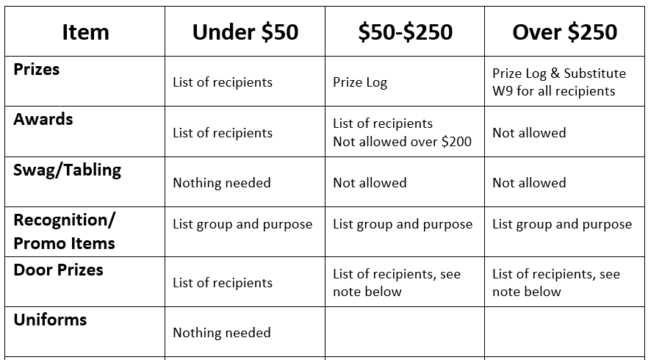
WSU
Documentation & Limits for Prizes, etc.
Limits
Exceptions may be requested and must have written approval from Brian Shuffield or Matt Shaw.
Not all requests to exceed these limits are allowable.

Slide 28
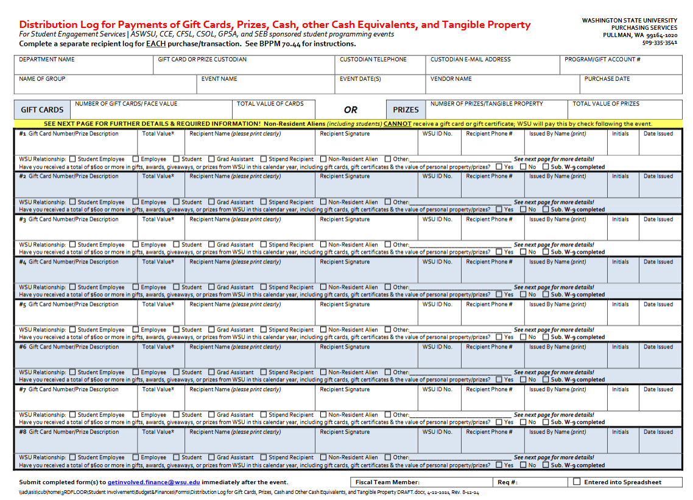
WSU
Form Link:
https://getinvolved.wsu.edu/forms
Notes:
Chloe

Slide 29
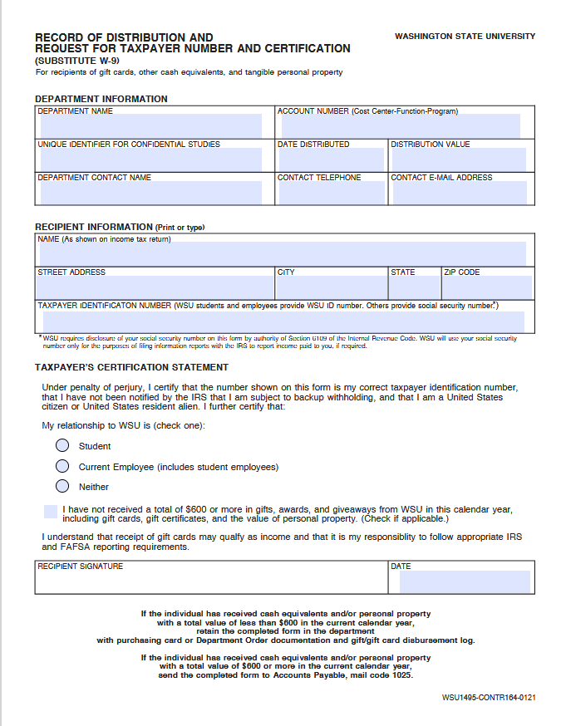
WSU
Form Link:
https://policies.wsu.edu/prf/documents/2017/10/45-53-record-of-distribution-and-request-for-taxpayer-number-and-certification.pdf/
Notes:
Chloe

Slide 30
WSU
Printing and Copy Services
WSU Design & Printing Services and WSU CougPrints Plus are our current suppliers for printing and related production services.
NOTE: Services from WSU Design & Printing Services may not be available after October 15, 2025 for new design requests. We will update information when it becomes available.
WSU Design & Printing Services must review and approve all printing requests to ensure compliance with state printing and procurement laws.
Department personnel may not send printing or estimate requests directly or electronically to outside suppliers.
For items that cannot be printed at WSU or provided at a reasonable cost, a written exception must be obtained from the Director of WSU Design & Printing Services (please attach the exception approval email to the Purchase Request form).
In-Person Orders – WSU CougPrints Plus (CUB 80, ground floor)
Submit your completed Purchase Request forms along with any other supporting documentation to your advisor at least 72 hours prior to your event or purchase date!
Your advisor will email the approved request forms and any supporting documentation to the SES Fiscal Team at getinvolved.finance@wsu.edu.
Give the final itemized receipts to the SES Fiscal Team or email to getinvolved.finance@wsu.edu.
Notes:
Chloe

Slide 31
WSU
Printing and Copy Services (cont’d)
Online Orders
WSU Design & Printing Services: https://staff.storefront.wsu.edu/home
WSU CougPrints Plus: https://cougprintsplus.wsu.edu/order-prints/
Submit your completed Purchase Request form along with any other supporting documentation to your advisor at least 72 hours prior to your event or purchase date -- BEFORE the order is placed.
Your advisor will email the approved request forms and any supporting documentation to the SES Fiscal Team at getinvolved.finance@wsu.edu.
Immediately after the online order is placed, forward the order confirmation to getinvolved.finance@wsu.edu.
Designs & Resources
Our WSU Student Affairs Marketing & Communications Team can assist with your designs and provide additional resources.
Please visit https://studentaffairs.wsu.edu/who-we-are/marketing-communications/services-resources/.
Submit your completed Purchase Request form along with any other supporting documentation to your advisor at least 72 hours prior to your event or purchase date -- BEFORE the order is placed.
Your advisor will email the approved request forms and any supporting documentation to the SES Fiscal Team at getinvolved.finance@wsu.edu.
Forward any order confirmations you receive to getinvolved.finance@wsu.edu.
Notes:
Chloe

Slide 32
WSU
Swag/Promotional Items
Please include a sample of your graphic design(s) with your purchase request form! Please allow extra time for customized items!
Any custom promotional items with WSU trademarks, logos and/or branding must be purchased from a licensed vendor through the WSU Student Affairs Marketing & Communications Team.
If the promotional item does not include items with WSU trademarks, logos and/or branding (such as SEB logos, RSO logos, etc.), you can select any appropriate supplier/vendor.
Other pre-made WSU branded items are available to order through WSU Design & Printing Services at https://wsu.presswise.com/catalog/?g=11&y=1025.
Submit your completed Purchase Request form along with any other supporting documents to your advisor.
Your advisor will email the approved request forms and any supporting documentation to the SES Fiscal Team at getinvolved.finance@wsu.edu. For SA Marketing orders, your advisor will send the approved documents to unionmarketing@wsu.edu and cc getinvolved.finance@wsu.edu.
Please forward any order confirmations that you receive to getinvolved.finance@wsu.edu.
Please send an email to getinvolved.finance@wsu.edu once you have received your order, along with a copy of the signed/dated invoice or packing slip.
Notes:
Denise

Slide 33
WSU
Purchasing Forms & Information Website:
https://getinvolved.wsu.edu/forms
Other topics that the Purchasing Information page covers that weren’t discussed today are:
Addresses – Mailing, Shipping & Pcard Billing
Insurance Coverage – Certificate of Insurance
Office Supplies – Contract with Office Depot
Reimbursement Requests for RSOs (non-travel) – Only for sponsorships by Crimson & Gray, GPSA, ISC or SEB.
Taxes – WSU is not tax exempt! Sales tax is based upon the point of destination (use, delivery or consumption).
If you have any questions, please ask your Advisor or the SES Fiscal Team!
Notes:
Chloe

Slide 34
WSU
Approvals & Deadlines! - Please plan ahead!
Prior approval is required! To assure compliance with all regulations, all purchases must have the appropriate prior approval. Any person making an unauthorized purchase must assume full responsibility for that purchase. (BPPM 70.01-4.1)
Deadlines for form submissions:
Purchase Requests: at least 72 hours prior to the event/purchase - longer for online orders
Prize Purchase Requests: at least 7 business days prior to the event/purchase - longer for online orders
Contract, Performance or Speaker Requests: at least 4 weeks prior to event/purchase
NOTE: There is a separate training that covers anything travel-related, (travel requests/approval, registration fees, hotel/lodging requests, motor pool rentals, airline fees, travel expenses, etc.). Please be sure to attend!
Notes:
Denise

Slide 35
WSU
Summary
Make sure the forms you submit to your advisor are COMPLETE! The details are IMPORTANT!
Email all request forms and any supporting documentation to your advisor for approval.
Your advisor will email the approved request forms to the SES Fiscal Team at getinvolved.finance@wsu.edu.
Send receipts, invoices, list of attendees, prize logs, confirmations, etc. to getinvolved.finance@wsu.edu (in pdf format please!).
Most of our required forms and information can be found at https://getinvolved.wsu.edu/forms *** Please add a bookmark to this website! ***
If you have questions about the process, please contact your advisor or call 509-335-9667 and ask for a SES Fiscal Team member.
Thank you! We hope you have a successful year full of fabulous events!
\\ad\asis\cub\home\3RDFLOOR\Student Involvement\New Coug Orientation & Experience WSU\Student Training\Fiscal team info for student training\Fiscal Training for Students 2025 (Purchasing).pptx, Rev. 9-5-25
Notes:
Chloe

